Slide 1
Communication skills in Palliative Care (or any situation)
Dr Robyn Thomas
PHT webinar series
Notes:
Patients / clients disclaimer ( or could be family member). Use word clinician to mean any health professional.
Many of you will already have these skills and be using them but you might not have had the opportunity to break them down to smaller elements and bring awareness to what you are doing. For those that teach, this is essential to be able to recognize a skill and give feedback on it.

Slide 2
Overview
Fundamental skills
Notice cues
Ask Tell Ask
Tell Me More
A framework – MVP
Emotions
Tips – small words, big impact
Notes:
Fundamental skills – ones that significantly save you time in a consult.

Slide 3
# 1. Notice Cues

Slide 4
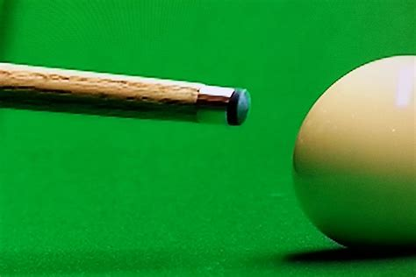
Notice cues
No, not that kind of cue!
Notes:
First fundamental skills – if you haven’t got cues you haven’t got anything

Slide 5
A hint, a clue
A hint to something further to be explored
A “red flag” in the conversation
Can be verbal or non- verbal
Notes:
Something further to be explored OR something else going on underneath that it would be helpful to know about. Usually something really important but because they have put it out as a cue, this means that the patient may be worried about if you will pick it up, if you care about it, or perhaps they wonder if they can trust you with it.
A red flag in the conversation.
AND – our patients also pick up on cues that we are giving out, getting the feeling that we can’t be bothered, or the feeling that we have all day for them – even though they know we are busy
Cues can be verbal or non verbal – lets look at some examples
Levinson W et al JAMA 2000

Slide 6
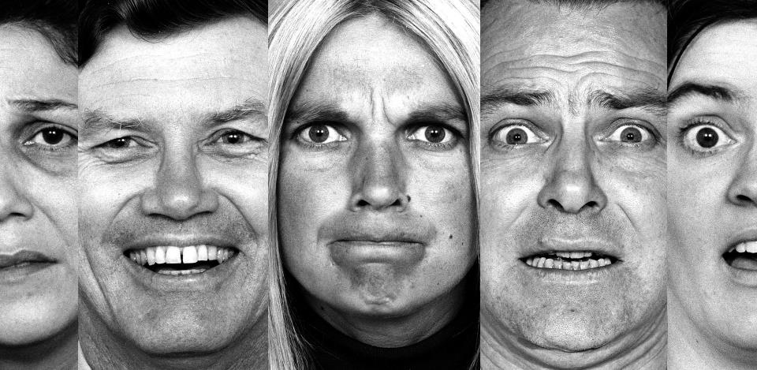
Notes:
Non – Verbal cues – or how we gather information from body language.
Getting the feeling that someone is not telling you something, or that they are not being totally honest, or that their words are not inline with what they are really “saying”
Covid / wearing masks etc
This is why phone call discussions are so much more difficult and feel fundamentally wrong if we have to try and display empathy or read emotions

Slide 7
Notes:
These guys might have been missing each others cues for some time

Slide 8
Notes:
And like wise, we can also see that nonverbally this clinician cares for this patient and is making a connection to them while they are sad.

Slide 9
Verbal Cues
Notes:
Verbal cues – not only WHAT is being said but HOW it is being said
These are usually a hint to emotional or psychological concerns.

Slide 10
Life threatening events
Notes:
For example: anytime someone mentions a life threatening event or a death I am likely to pick up on it and explore it because I know it is likely to be helpful.
My mother died last year ..
I have 4 children, one died when he was 16…

Slide 11
Circular conversations
Notes:
Sometimes a conversation appears to be going round in a circle… this is often a cue that there is an emotional issue that is not being addressed. Sometimes you hear in the ward – well we have explained that to her several times….
Eg Nursing home – daughter made a promise not to put mum in one…
Think what is happening on an emotional level that we are not picking up on

Slide 12
Future events
Notes:
I am just looking forward to Easter / The family are coming over at Christmas / My daughter is expecting a baby
The cue – they might want to talk about time frames… eg ..” I am wondering if you are worried you might not make Christmas OR “ I am wondering if you are worried about time you might have.. OR

Slide 13
a LOADED emphasis
Notes:
Examples
I don’t need the HOSPICE ….
Its not ME that matters….
Its not the NURSE who is the problem….

Slide 14
Why should we notice cues?
The consultation takes a shorter time
The patient feels listened to
We understand what matters
Decisions tailored to patient goals
Less complaints
AND We have more job satisfaction

Slide 15
# 2. Ask Tell Ask
Notes:
ATA is a great skill to use if you need to make your conversations more efficient. When used it can save you a lot of time.

Slide 16
Ask Tell Ask
Build on what the person already knows
ASK – check understanding / readiness / expectations
TELL – share the information
ASK – check understanding / reaction
Notes:
For example – asking about whittle ward..

Slide 17
Do you think I’m going to get better?
Notes:
So here is some examples of options when a patient asks a big question like “how long have I got” or : do you think I will get better from this”

Slide 18
No…..
Do you think I’m going to get better?
Notes:
You might panic a bit and you are thinking… NO… and suddenly that comes out...

Slide 19
No…..
Do you think I’m going to get better?
Notes:
Rather blunt!

Slide 20
Rewind + Replay

Slide 21
Do you think I’m going to get better?

Slide 22
I am sure you will…..
Do you think I’m going to get better?
Notes:
False reassurance, not picking up on the cues / emotion

Slide 23
Rewind + Replay

Slide 24
Do you think I’m going to get better?
Notes:
Instead, use ATA before you do any telling

Slide 25
What do you think?
Do you think I’m going to get better?
Notes:
Using ASK to find out more information before doing any telling.
Might also say… I am wondering what your thoughts are?

Slide 26
I think this might be as good as it gets…
Notes:
Instead, use ATA before you do any telling

Slide 27
I think you might be right….
I think this might be as good as it gets…
Notes:
The “telling” bit becomes far easier as the patient is already there.
And if they are not – the you can tailor your medical information to where they are at.

Slide 28
Ask Tell Ask
Helps you to “tell” because you can build on what they already understand
They might be there already
They might be miles away

Slide 29
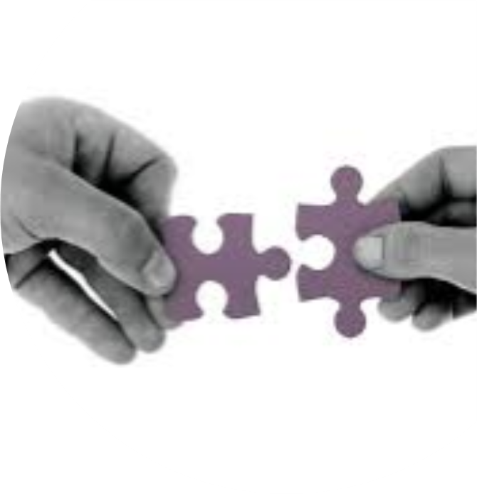
# 3. Tell Me More
Do you understand what they mean?
Are you stuck?
Want to follow a cue?
Use” Tell Me More”
Notes:
TMM is a great phase that can be used a lot to navigate a conversation, particularly to find out information.
For example – if they use words like crap / funny / woosy
TMM is also a great phrase to use if you are stuck in any conversation. It shows you are still interested, and also can give you time to think about what might be going on OR to settle your own emotions (especially if they have just asked you a tricky or emotional question)

Slide 30
I’m worried about going back to the hospital
Notes:
That’s a CUE!!
We could ignore it rather than follow it…

Slide 31
I’m worried about going back to the hospital..
I’m sure you will be ok.
Notes:
!
False / early reassurance

Slide 32
I suppose I will…
Notes:
Conversation finished, no chance for deeper understanding or empathy

Slide 33
Rewind + Replay

Slide 34
I’m worried about going back to the hospital..
Notes:
Another example…

Slide 35
I’m worried about going back to the hospital..
Can you tell me more about your concerns?
Notes:
That’s a cue! We don’t know what they are actually worried about. (when you don’t know… use TMM)
Use TMM to find out what is going on for them … or just “tell me more” or Hmmm ??”
HAVE A GUESS – about what he might be worried about… see if you can get it right – your brain will have already made up a story…

Slide 36
They always forget that I’m a vegetarian.

Slide 37
I’m worried that my wife isn’t coping

Slide 38
I can get you back into see the psychologist to help..
I’m worried that my wife isn’t coping
Notes:
Jumping to a solution too early

Slide 39
Rewind + Replay

Slide 40
I’m worried that my wife isn’t coping

Slide 41
Tell me more about what is happening…
I’m worried that my wife isn’t coping
Notes:
Using TMM to find out more to direct your answer or solution

Slide 42
I think she is having an affair with our psychologist…

Slide 43
Tell Me More
Clarifies what they are telling you so that:
You don’t make assumptions
You might be able to help
Your “plan” is tailored to what they actually need
OR – you can be empathic
Your consult will be more efficient
Notes:
TMM summary

Slide 44
MVP
M – Medical situation
V – Values
P - Plan
Notes:
From a recent article by Robert Horowitz, et al NY for simplifying all serious news conversations (2020) . They looked at models for communication skills and developed the most memorable model they could – meaning you have more head space to focus on the conversation itself. Because when a serious conversation comes along you want to concentrate on the conversation rather than try to recall a framework or nemonic.
I really like this as it is the essence of patient care – their medical situation, their values and a plan.

Slide 45
MVP
M – Medical situation - my stuff
V – Values - their stuff
P – Plan - working together
Notes:
My simpler view of it

Slide 46
Medical situation
Every serious conversation depends on the patient having the best understanding of the relevant illness(s), treatment options, prognosis
Nearly all patients want the basics and most want to discuss prognosis
Notes:
Every serious conversation depends on the patient having the best understanding of the relevant illness(s), treatment options, prognosis. Although clinicians are often hesitant to share bad news with patients, nearly all seriously ill patients want to know at least the basic features of their illness and most want to discuss prognosis. This understanding is fundamental to informed decision making, optimal personal automomy and patient and family satisfaction with the plan.
Pitfall area – for example family not understanding that dementia is a progressive terminal illness

Slide 47
Medical situation
Headline statement
or…
Warning shot
or…
Ask Tell Ask
Notes:
A headline statement – what is happening medically and what it means practically for them.
Could be a warning shot eg “ the scan is not good news”
Eg The medication is not making Joe any better and I am worried he is getting sicker
Eg We are in a different place now
Eg I am worried that time is shorter than we had hoped
If you have just met this person for the first time – check in what they know first – use ATA
EG What is your understanding of your cancer?
EG What did they tell you at the hospital?

Slide 48
Values
Beliefs
Goals
Priorities
Ideology
Narrative
Hopes, fears
Information and decision making preferences
Notes:
All of these things, in the context of the now understood medical situation.
Patient values might be general – inherent and overarching OR contextual – found through a lived experience both of which are relevant in defining treatment preferences.(eg going to whittle ward as example)
That is why values follows the medical situation step – values can only be meaningly explored when the extent of the medical situation in understood.

Slide 49
Values
Given this information, what matters most to you?
What does it mean for you?
What are you hoping for?
What worries you about that?

Slide 50
Plan – make a recommendation
Now that I know what is important to you, I’d like to offer a recommendation, is that okay?
Would it be ok if I gave a suggestion?
AVOID….
What would you like to do?
Notes:
A plan obviously follows the previous 2 parts of the conversation – integration of both the medical situation and the patient’s values. A plan may be regard the conversation process itself as the plan – rather than it being some specific medical treatment. For example – if the medical information is one of bad news, then the conversation may have a lot of emphasis on empathy and when to discuss things again, rather than on treatment options. Many serious discussions will not necessarily achieve clarity and closure of a plan in a single cycle but rather over a series of conversations depending on the clinical urgency and patient factors
Going to the lawyer as an example. Getting your car fixed as an example.

Slide 51
Focus on what you will do…
Focus on making your Dad comfortable
Use this important time to be with family
Keep you here and do our very best to avoid going to the hospital
AVOID
Stop active treatment
Move to palliate
Actively palliating
Notes:
When making a recommendation, focus on what you ARE going to do, rather than what is not going to be done
- Patient from St Helens – LGH – RHH as example of values given the medical situation and then the plan

Slide 52
Emotions
Notes:
Lets go deeper with emotions

Slide 53
Emotions block data

Slide 54
Notes:
I like to see emotions as a wave, and we use that language around it. It swept up over me, A wave of sadness..

Slide 55
Emotion graph…
Level of emotion
Notes:
If you are more into Math than art then another way is to make it into a graph…

Slide 56
Emotion graph…cues
Level of emotion
Notes:
We notice cues here when the person / patient is starting to experience an emotion

Slide 57
Emotion graph…cues
Level of emotion
Notes:
At the top of the emotion the person will not be very good at taking in information or being able to listen to instructions or process what is happening

Slide 58
Emotion graph…cues
Level of emotion
Notes:
Once the emotional wave is settling (and this may only be a few seconds or a minute or so) the you might see – they are engage, they make eye contact, they might ask a information or data question or they might apologise. This is when their frontal lobes are starting to function again and they will be able to process information.

Slide 59
Emotion graph
Level of emotion
Notes:
The important thing is to let the person get over the wave to this point. Why? Because we feel better once we have gone over the wave of emotion eg “ have a good cry” Punch a pillow and let it all out” Ie this is a therapeutic process that is better than any medicine that we can give them.
The key for us is what to do in the time that they are in the emotional space – how should we respond to the emotion

Slide 60
Responding to emotion
Not this kind of responding!
😤
😂
🤭
😐
😬
😱
😍
😟
😭

Slide 62
Name it
Notes:
Easiest thing to do once you have noticed the emotion. Then we can name the emotion – often Slightly understating so they can build on it
It sounds like this has been really frustrating?... Patient = Frustrating- unbelievable annoying
It seems like you are really sad. Patient = totally gutted
It is an invitation to our patients to tell us how they are feeling

Slide 63
Sounds like…
Seems like…
Notes:
Empathic statements start with.. Seems like… sounds like.. (give examples) A curiosity of the perspective of another person.
Empathic statements do not start with I know or I understand or At least. – examples.
Rarely does and information or data response make the person feel better. What makes it better is sitting in the emotional space and connection.

Slide 64
Other empathic ways..
This is not what we wanted.
There is so much going on for you
I can only imagine how hard this is for you
This is just not fair
Avoid
I know how you feel
I understand how you feel
It’s ok
At least…..
Notes:
Other empathic statements / I can see the impact this news has had. / This is not what we wanted / it seems unbearable.
If I have understood you, the most upsetting thing is losing the chance to see your children grow up and marry
You have been amazing to look after your mother all this time
Its not fair- you had the surgery, had the chemo and radiotherapy and coped with all the side effects and yet your cancer has spread.
I cannot believe how you have managed to care and protect your children whilst dealing with all the treatment side effects,
The practice / I will support you – you do not have to do this alone. Whatever your decision Abandonment..
Empathic statements do not start with I know or I understand or At least. – examples.
Rarely does and information or data response make the person feel better. What makes it better is sitting in the emotional space and connection.
eg … to a lady who has just had a miscarriage “ At least we know you can get pregnant..”

Slide 65
Tips – little words matter!

Slide 66
AND BUT

Slide 67
Hypothetical enquiry
Notes:
The use of a statement or question starting with IF… helps to put it in a hypothetical situation / one that seems removed from the actual reality and so can help people think about it
Hypothetical enquiry or hypothetical questions are a way of talking about the future in the 3d person, or removing it from the immediacy of the current situation so that it is not so threatening.

Slide 68
Hypothetical
I really hope that (the intervention) is successful. IF not… have you had any thoughts about the future?
IF time was short, what would be most important to you?
Notes:
Eg – 6 week surgery story from NZ

Slide 69
I wish…
Notes:
I wish statements are a really powerful way of aligning with the patients wishes, making a connection with them and showing that you understand them, at the same time as acknowledging that those wishes are… well… wishes

Slide 70
I wish… I hope…
I wish that an operation could change things
I wish that CPR could change what is happening
I hope your mother gets here on time
Notes:
A wish is already an acknowledgement of something that might not happen.
Very empathic way of aligning with someone.

Slide 71
Working with hope…
It would help me if I know what it is your are hoping for at the moment
Likely response = something unachievable like a cure or longevity
I really hope for that too. Many people hope for many things. What else are you hoping for?
I really hope for that too. If things don’t turn out that way, is there anything else you are hoping for?
Notes:
Hope for the best.. And it might be good for us to plan for a few possibilities…

Slide 72
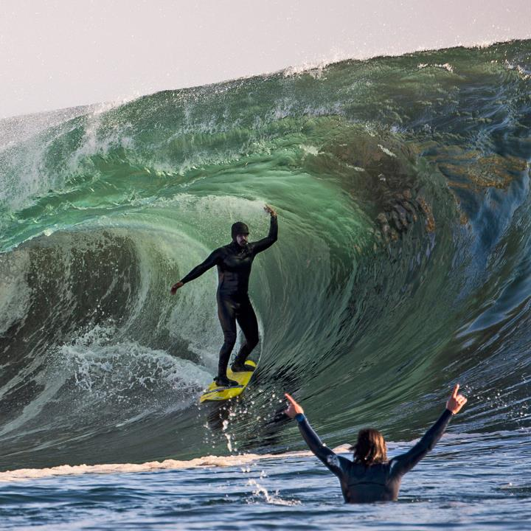
Notes:
So ride the wave of emotion with your patient and families, and be brave to sit in that space with them to work together
Go well, thank you.

Slide 73
Notes:
Happy patients!

