Slide 1
Grand round
Transcranial magnetic stimulation (TMS)
S Pridmore, Y Turnier-Shea, M Rybak

Slide 2
MAJOR DEPRESSIVE DISORDER
Epidemiology
Life-time prevalence in western societies is 5-9 %.
More common in females.
Average age of onset – mid-20s.
Prognosis
1/3 do not achieve remission.
80% of those who achieve remission have recurrent episodes.
1/3 experience relapse while continuing their treatment.
3.4% - MDD will complete suicide

Slide 3
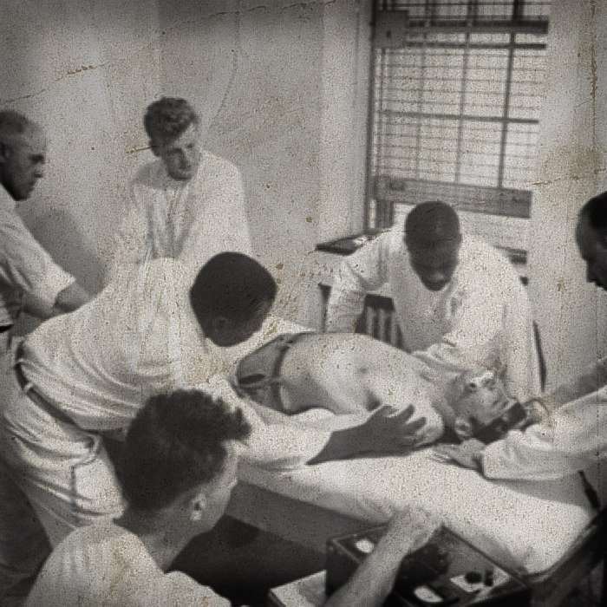

Slide 4
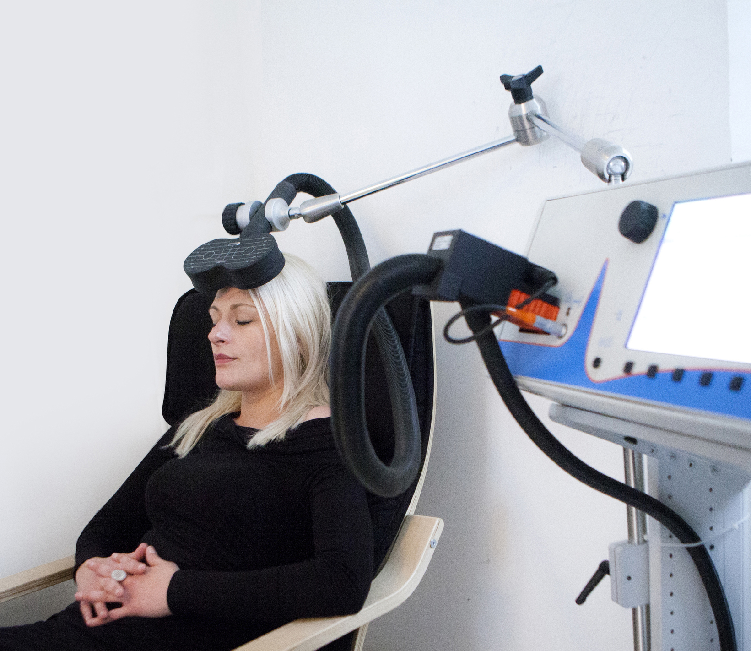
Transcranial
magnetic
Stimulation
(TMS)

Slide 5
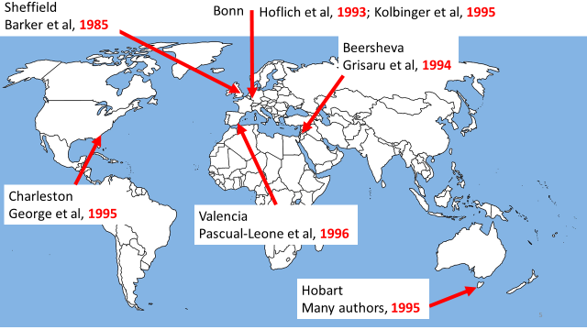
First TMS Treatment
First placebo-controlled trial

Slide 6
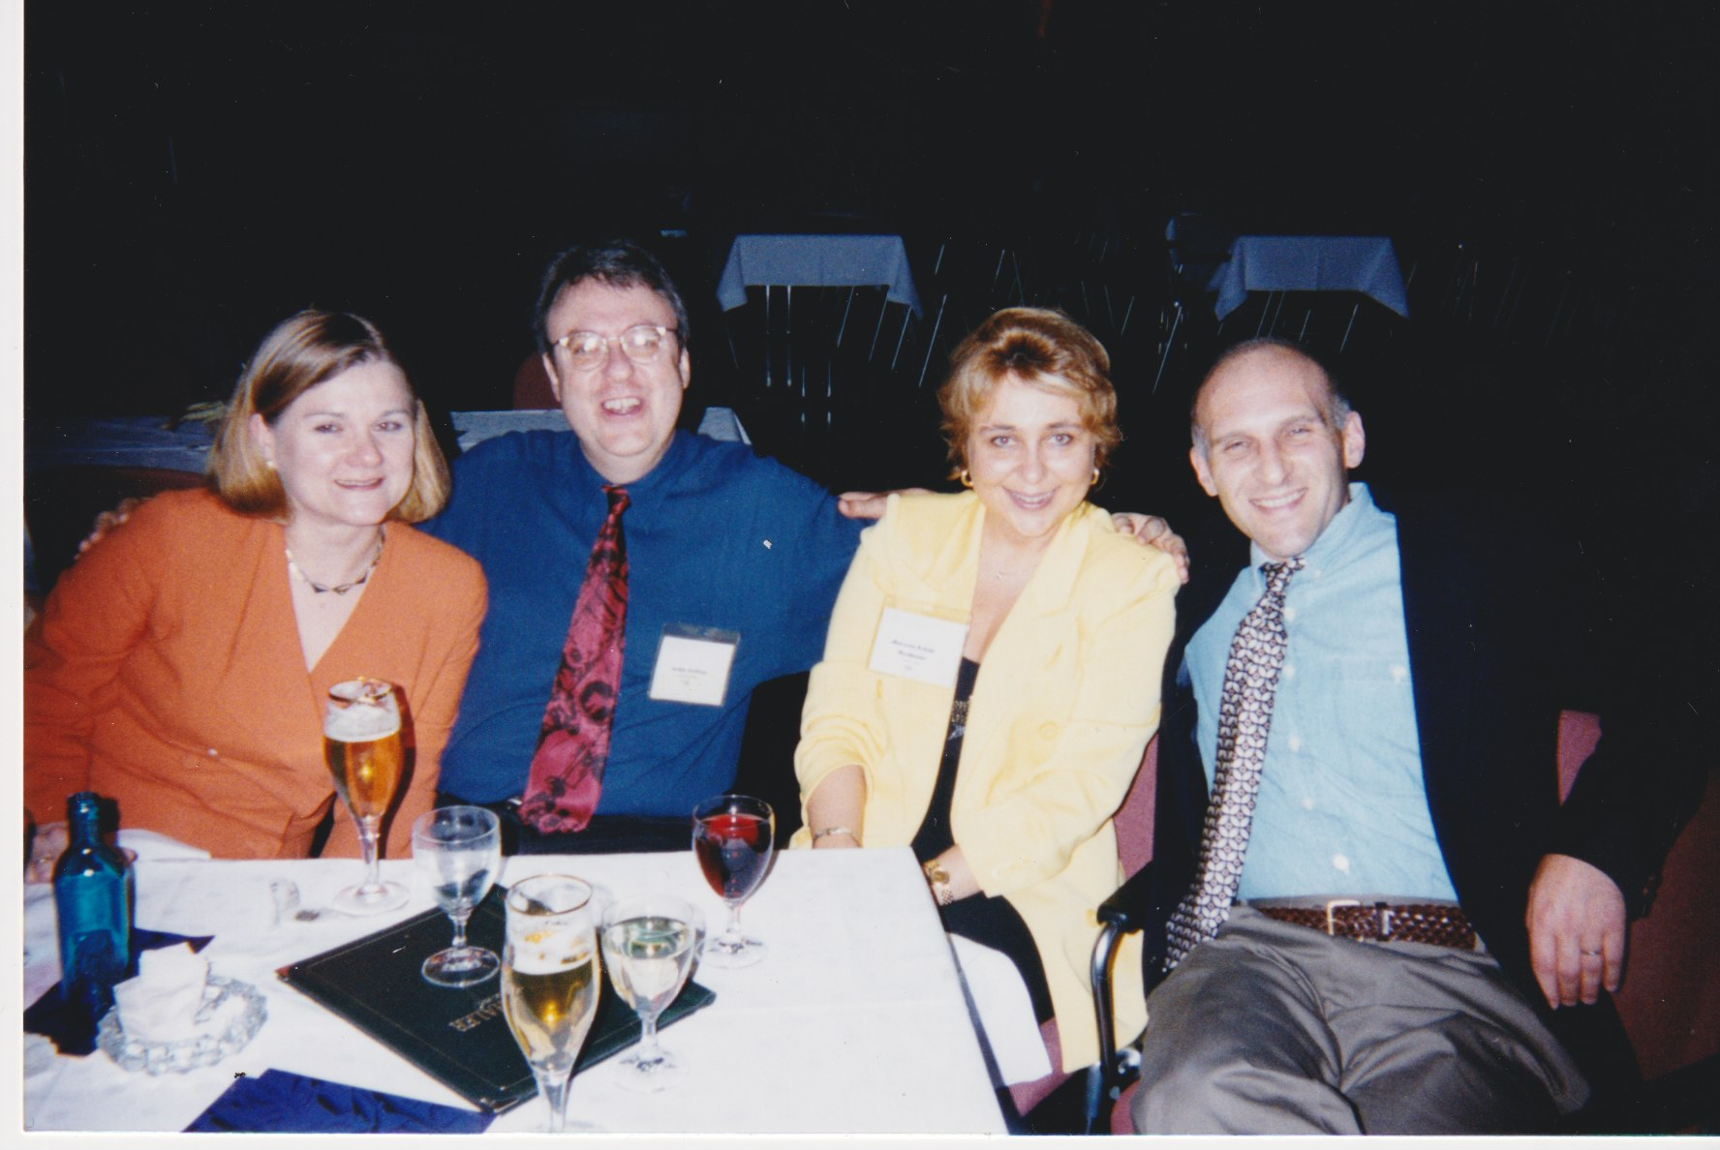
Prof J Grafman
Northwestern University
First TMS Treatment
Prof E Wasserman
NIH
First placebo-controlled trial
Pioneers
Gottingen, Germany, 1998
Gottingen, Germany, 1998

Slide 7
Rate of acute remission and probability of sustained benefit at each level of STAR*D
Sackheim H. Brain Stimulation 2016; 9: 313-319.
Acute Probability
remission of sustained
rate benefit
Level 1 36.8% 25.7%
Level 2 30.6% 13.7%
Level 3 13.7% 4.9%
Level 4 13.0% 3.8%
Sequenced Treatment Alternatives to Relieve Depression

Slide 8
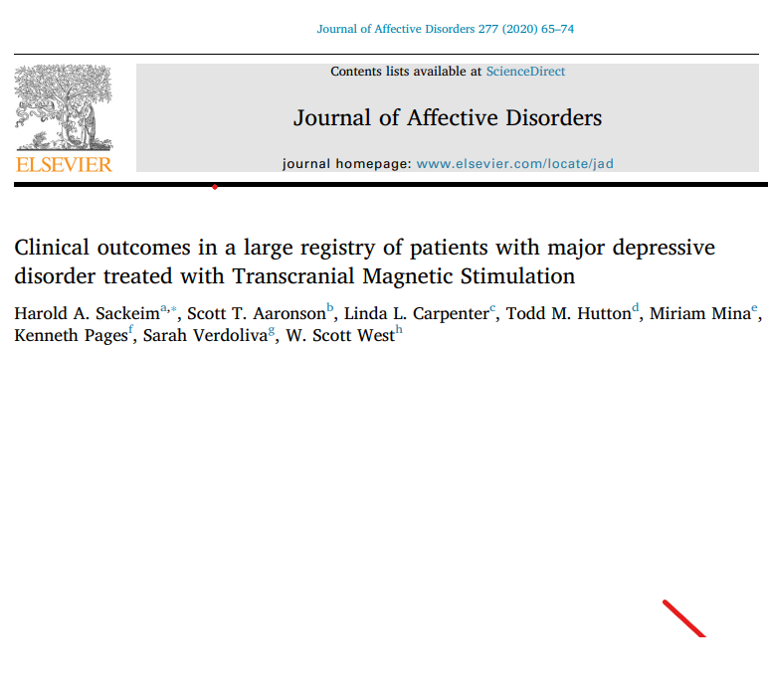
Clinical outcomes
Response: 58-83%
Remission: 28-62%

Slide 9
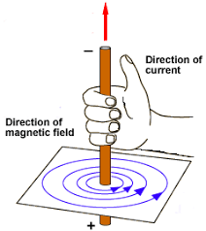
The Right-Hand Rule
Notes:
When electricity runs along a wire, a magnetic field extends out at right angles to the current. The Right-Hand Rule tells that about the “direction” of the magnetic field – this is too much information – all we need to know is that a magnetic field accompanies electric current movement.
We mustn’t use your electric shaver while you check the compass on the bridge of our ship. Why is that?

Slide 10
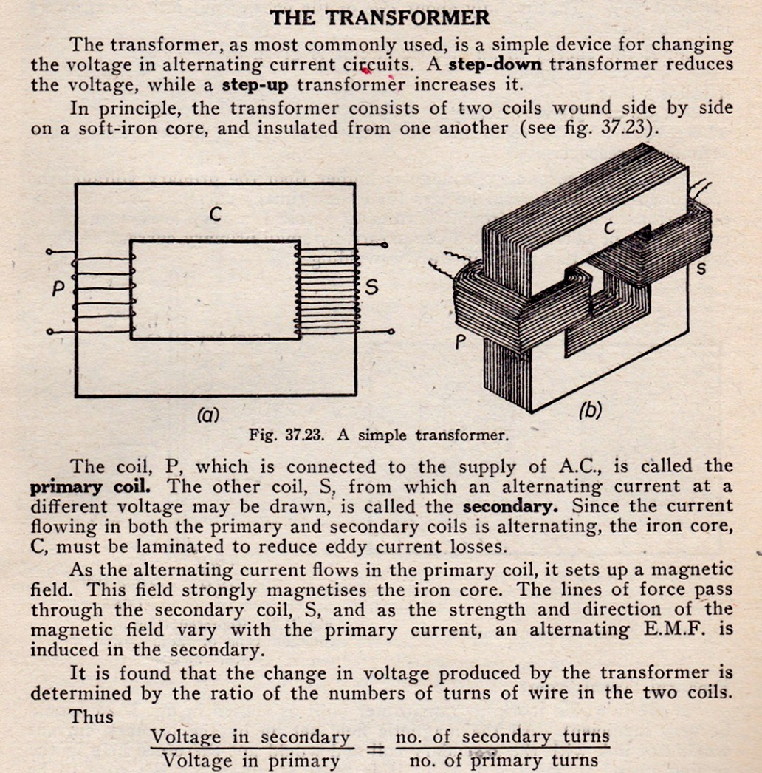

TMS jumps electricity across the skull to the brain.

Slide 11
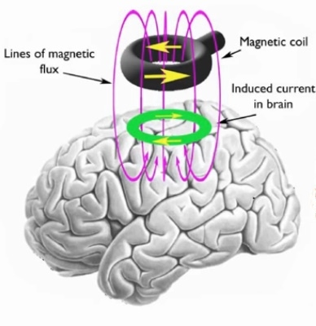

Slide 12
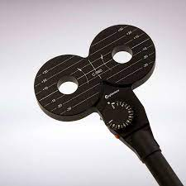
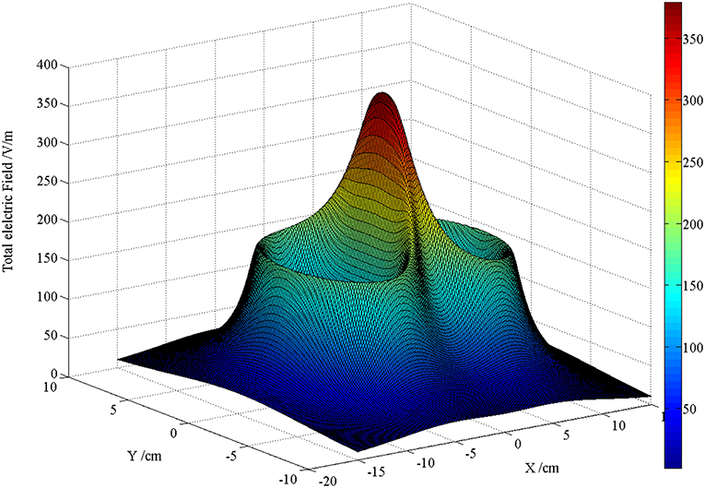
Electric field projecting from the center of the figure-of-eight coil.

Slide 13
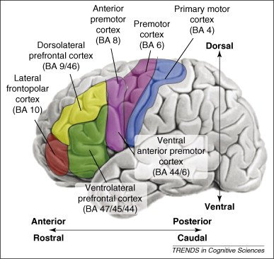

Slide 14
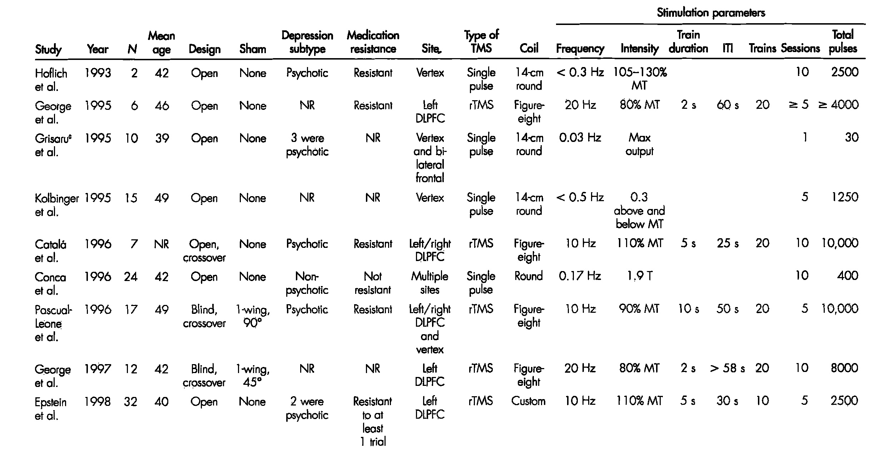

Slide 15
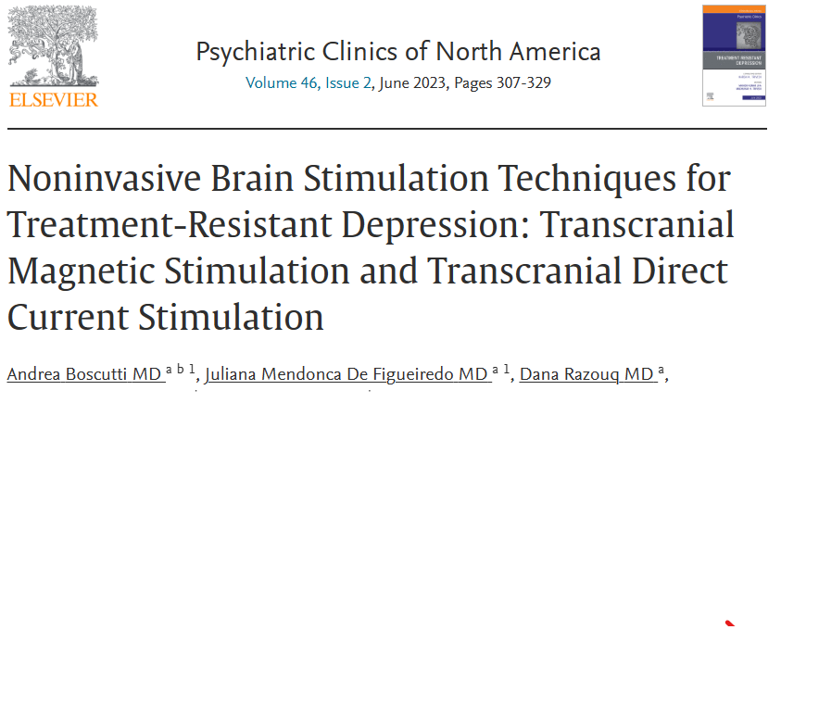
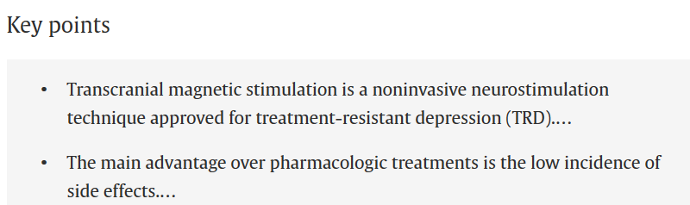

Slide 16
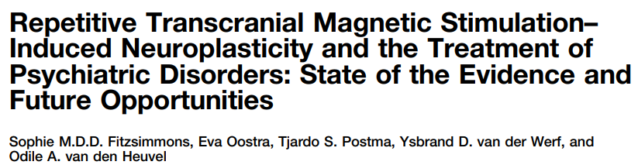
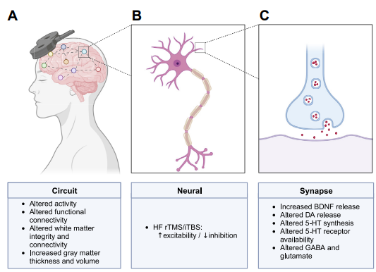
Biological Psychiatry 2023

Slide 17
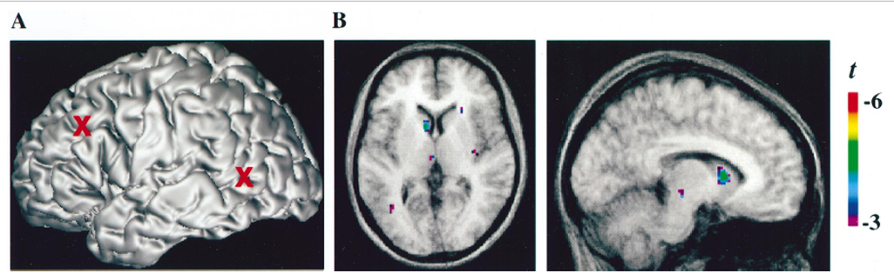
TMS stimulation – Left DLPFC
Left caudate – [¹¹C]raclopride binding reduced significantly.
Indicating: TMS to Left DLPFC induced (via corticostriatal projections)
endogenous dopamine release in the ipsilateral caudate.
Strafella A et al. J Neurosci 2001; 21: RC157. A PET study

Slide 18
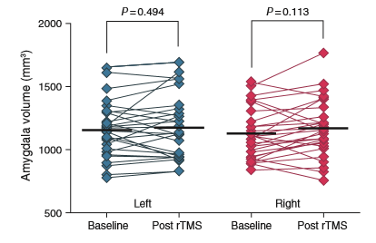
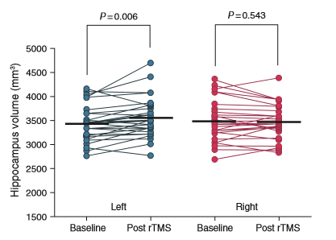
Lateralized hippocampal volume increase following high frequency left prefrontal rTMS
in patients with Major Depression. (Hayasaka et al, Psychiatry Clin Neurosci. June 2017)
Significant volume increase in the left hippocampus post left DLPFC TMS
(not the right hippocampus or the amygdalae).
amygdalae hippocampi
Notes:
This paper explains that the treatment of people with MDD with TMS resulted in a significant increase in the volume of the left hippocampus – unfortunately, the illustration does not make that point very well.

Slide 19
Connectivity is concerned with the amount and ease (speed) with which brain nodes communicate with each other.
Anatomical/structural connectivity
Imaging studies show us that something is broken.
Functional connectivity (FC)
Nothing looks broken, but something isn’t working.
FC problems are often present in psychiatric disorders.
Can be assessed using brain imaging – also, using non-imaging EEG.

Slide 20
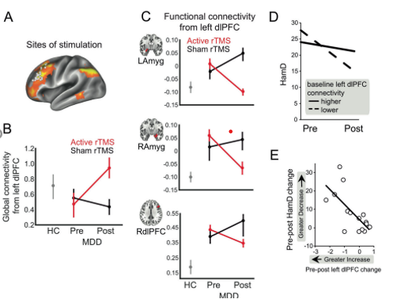
Global connectivity
and local excitability
associated with
antidepressant effects
of TMS
TMS increases global connectivity
and decreases amygdala connectivity
Eshel N, et al.
Neuropsychopharmacology
2020; 45: 1018-1025

Slide 21
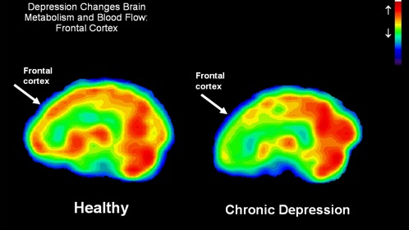
Notes:
Metabolism and blood flow - in the chronic depression group, there is markedly decreased in the frontal lobes – we try to increase that activity

Slide 22
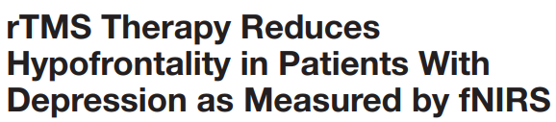
Kowabata Y, Imazu S, Matsumoto K, et al.
Frontiers in Psychiatry 2022; 13: 814611

Slide 23
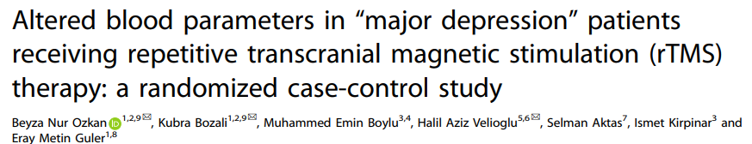
Translational Psychiatry (2024) 14:264

Slide 24
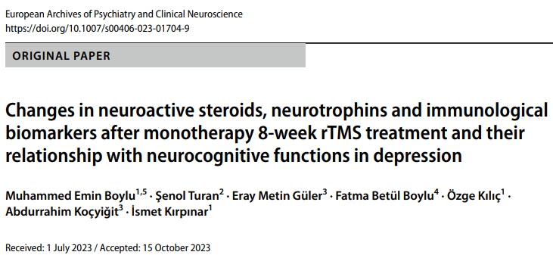

Slide 25
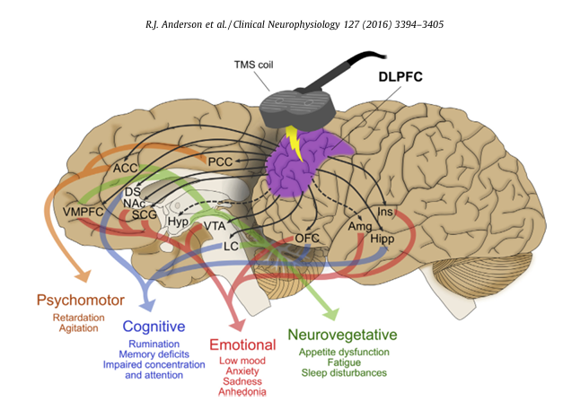

Slide 26
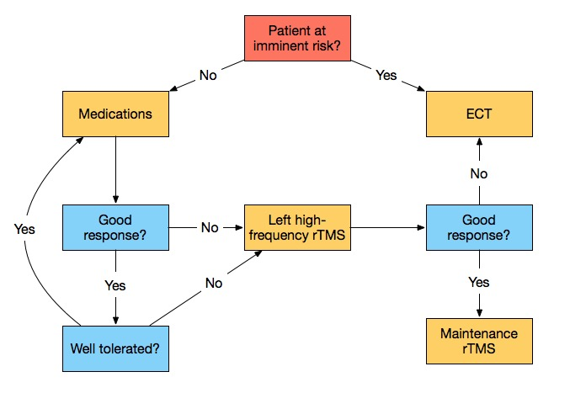
Pridmore W. Australas Psychiatry. 2021;29:207-213.

Slide 27
A course of TMS is a considerable undertaking
for both patient and staff.
A standard course is usually 25-35 daily treatments
[5-7 weeks] (weekdays only)
Each treatment takes 40 minutes.
A staff member must be close at hand at all times.
Relapse and retreatment is quite common
This does not mean TMS is weak, but that MDD is strong.
Thus, there is a place for Maintenance TMS

Slide 28
Medical Benefit Scheme – TMS Item Numbers – Available Nov 2022
Welcome but sever limitations
Patients treated with TMS before Nov 2022 – not allowed rebate – makes no sense
Lifetime limit of 50 sessions. One course may extend to 35 treats. Depression is a chronic, relapsing disorder. Not even 2 full treatment courses are allowed in a lifetime.
Maintenance TMS is effective [2 forms exist] but is not covered by current item numbers.

Slide 29
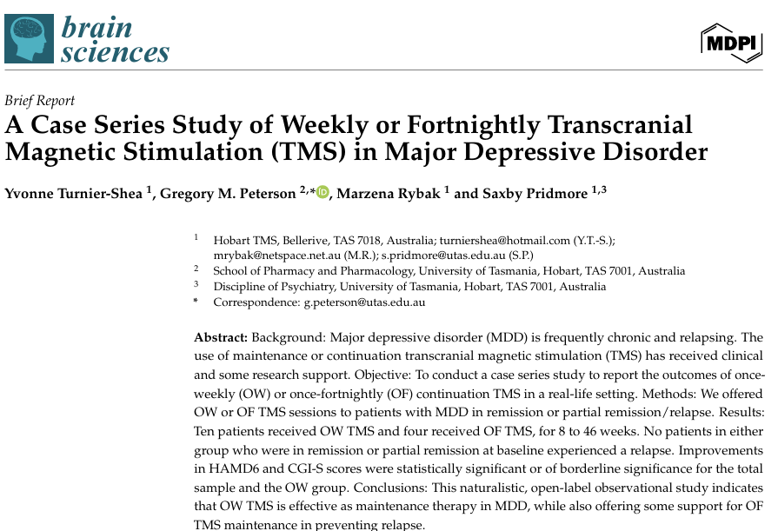
Brain Sci. 2024, 14, 415. https://doi.org/10.3390/brainsci14050415

Slide 30
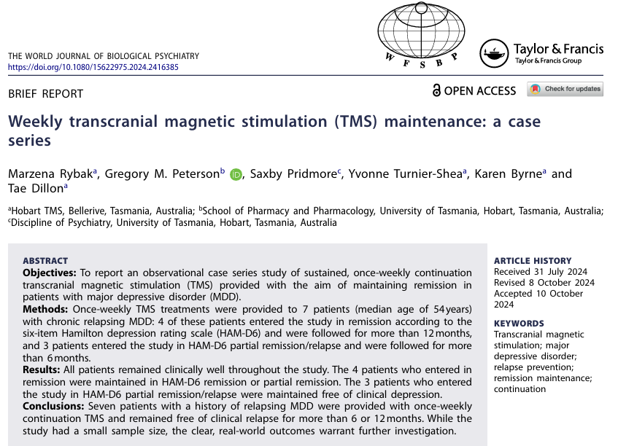

Slide 31
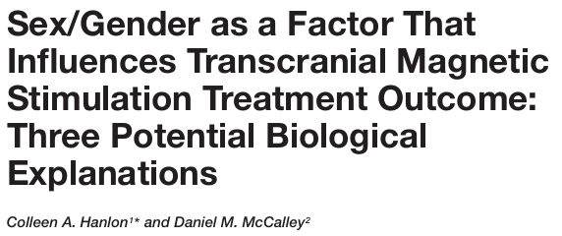
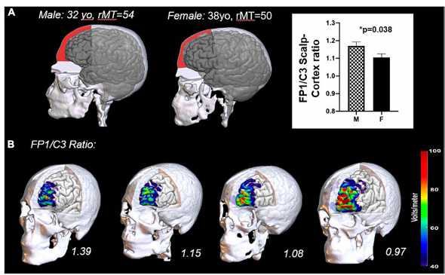
Frontiers in Psychiatry 2022. 13:869070

